Slide 1
Project Presentation for MET CS 521 A2 (INFORMATION STRUCTURES WITH PYTHON)
ANALYZING THE EFFECT OF HOME CROWDS ON RESULTS OF SOCCER MATCHES
Instructor Name: Professor Eugene Pinsky
Student Name: Naman Singhal

Slide 2
Introduction
In Soccer(and many other sports), the home team always seem to have an advantage of having their fans cheering for them, creating an atmosphere to make them perform to their best. This has been a popular observation.
Now, in response to the coronavirus pandemic, soccer matches are played without crowds. This gives an interesting opportunity to study the observation stated above. I have made an attempt to compare the results(at home and away matches) for the last 5 seasons.

Slide 3
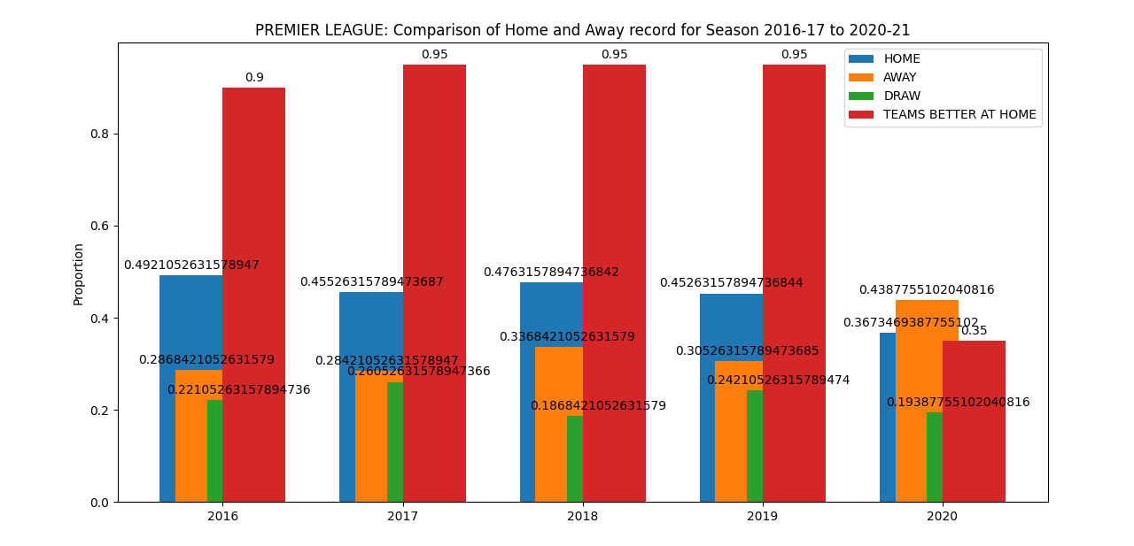
Premier League(England)

Slide 4
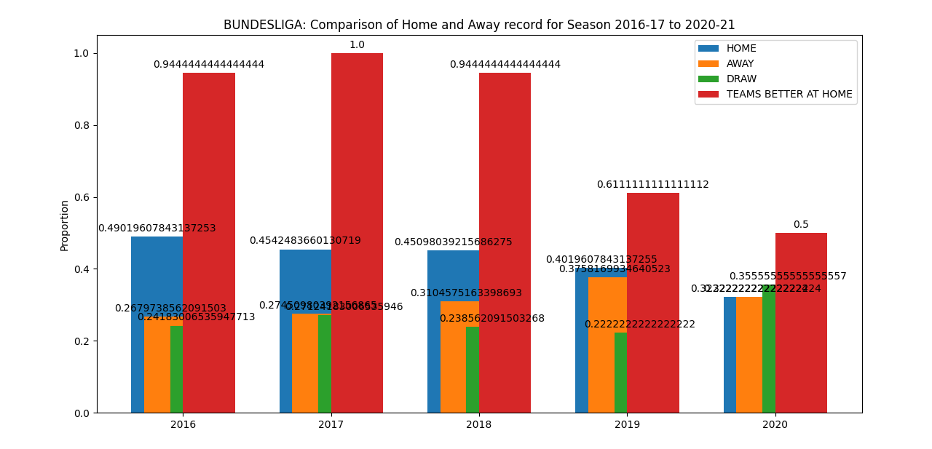
Bundesliga(Germany)

Slide 5
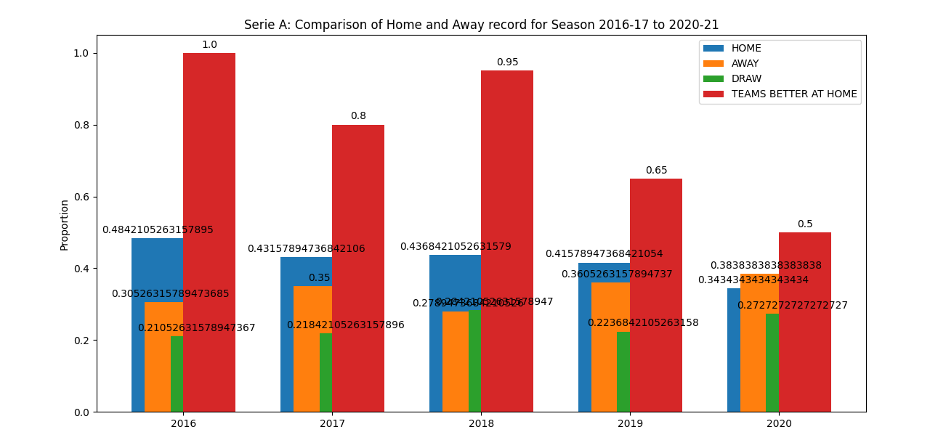
Serie A(Italy)

Slide 6
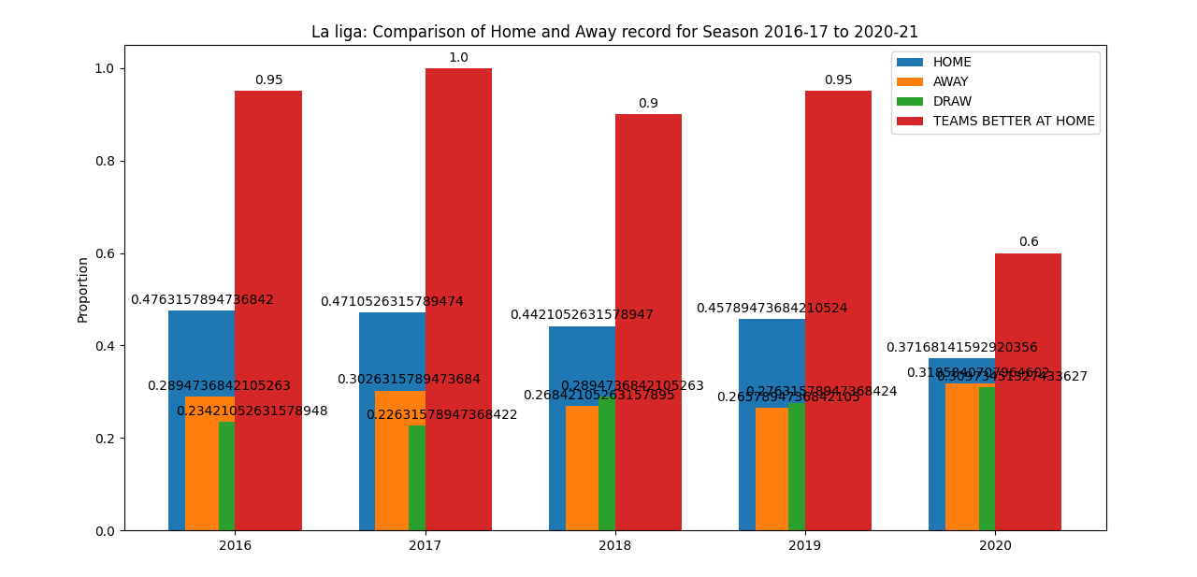
La liga(Spain)

Slide 7
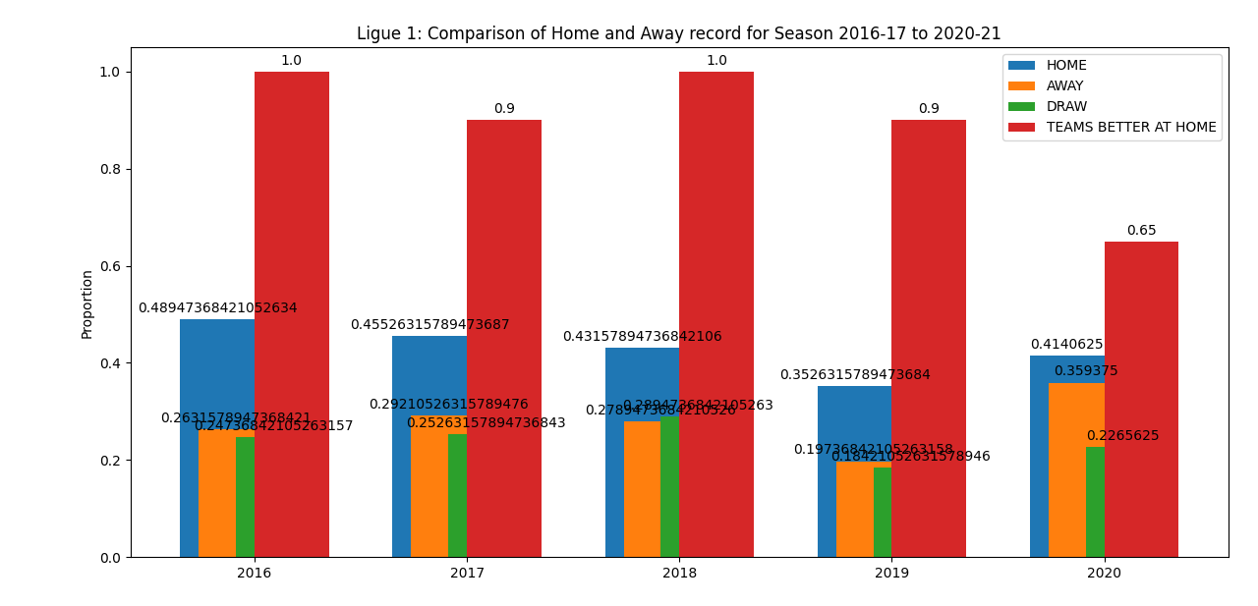
Ligue 1(France) – relatively less restrictions

Slide 8
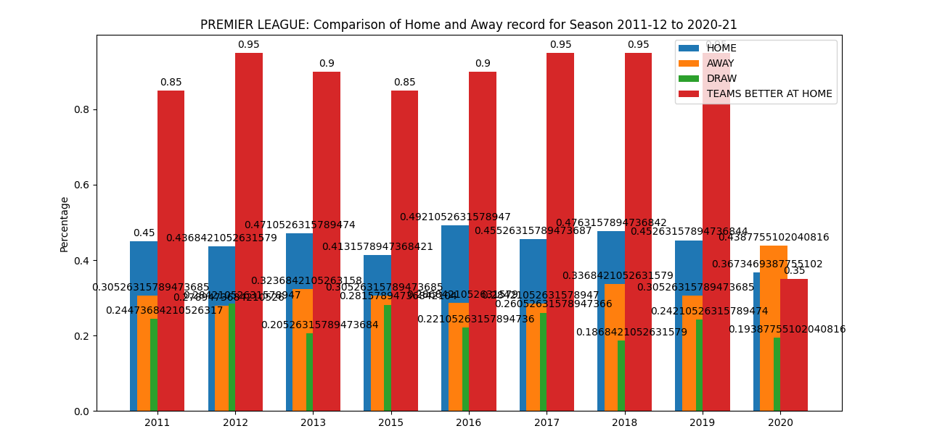
Premier League 10 year

Slide 9
Observations
Teams with better home record(as compared to their away record) have decreased to half!! in the games without fans.
% of home wins has decreased and that of away wins has increased
One of the league we studied(Ligue 1) had fewer restrictions on fans allowed to watch the match(limited audience allowed). Our analysis in this league showed same trend but with relatively lower variation.
Notes:
Used to be pretty much every team used to have a better record at home, but that is the trend that has reversed the most.

Slide 10
Challenges and Obstacles
Organizing a big code(often, I would lose track(especially after a break of more than a day))(modification of the code, retaining the previous code(GIT?))

Slide 11
Future(OR What I would have done with more time and knowledge)
Better Visualization(matplotlib?, ggplot(R)?)
Apply predictive modelling(ML techniques?)

Slide 12
Datasets:
All datasets used in the project were open source from football-data.co.uk

Slide 13
Thank You! ☺

